Slide 1

Exam AZ-301-304: Microsoft Azure Architect Design Crash Course
Tim Warner

Slide 2


Tim Warner
Based in Nashville, TN, US
Central time zone
MCT, MVP
Twitter: @TechTrainerTim
Badge: TechTrainerTim.com

Slide 3
Course Materials
timw.info/az301

Slide 4
Session 1 of 2 Learning Goals
Design Monitoring
Design Identity and Security
Design Data Storage
Design Business Continuity

Slide 5
Session 2 of 2 Learning Goals
Design Migration
Design Infrastructure
Design Application Architecture
Exam AZ-301-304 certification strategy

Slide 6
Setting Expectations
Azure Architect is an expert-level certification
You should already know how to deploy and configure Azure resources
This is a "crash course"
Please plan to review these materials more than once
Five-minute break at midpoint
Please ask/answer questions and provide feedback in the Q/A panel, not the group chat

Slide 7
2020 Exam Update Information
Microsoft Worldwide Learning (WWL) revisits the Azure role-based certs yearly
Relevant blog post: timw.info/az2020
Changes:
AZ-300 replaced with AZ-303
AZ-301 replaced with AZ-304
AZ-304 beta is available now
AZ-301 retires around September 30, 2020

Slide 8
2020 Exam Update Information
You can earn your badge by combining the old and new exam versions:
AZ-300 and AZ-304
AZ-301 and AZ-303
The certification is the same, and has a 2-year expiry

Slide 9
Tim's Certification Study Pyramid
Interdependence
Content knowledge
Practical application
Test-taking skills

Slide 10
Consumption, Auditing, Monitoring Design

Slide 11
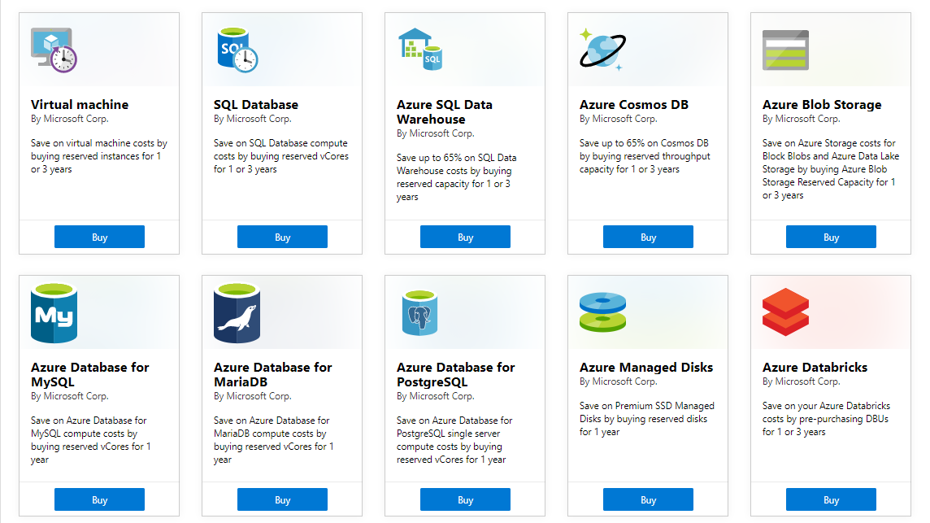
Azure Reservations

Slide 12
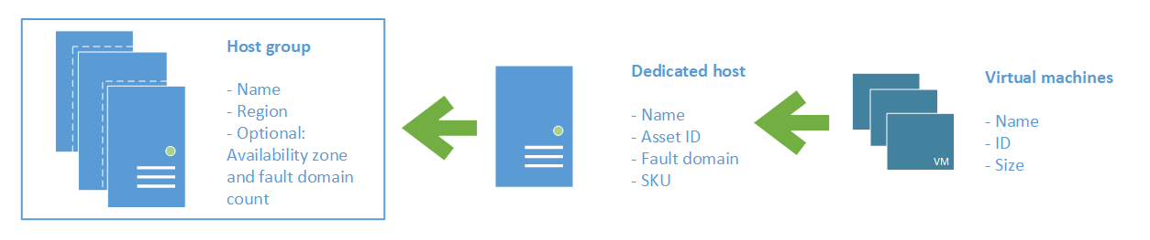
Azure Dedicated Host

Slide 13
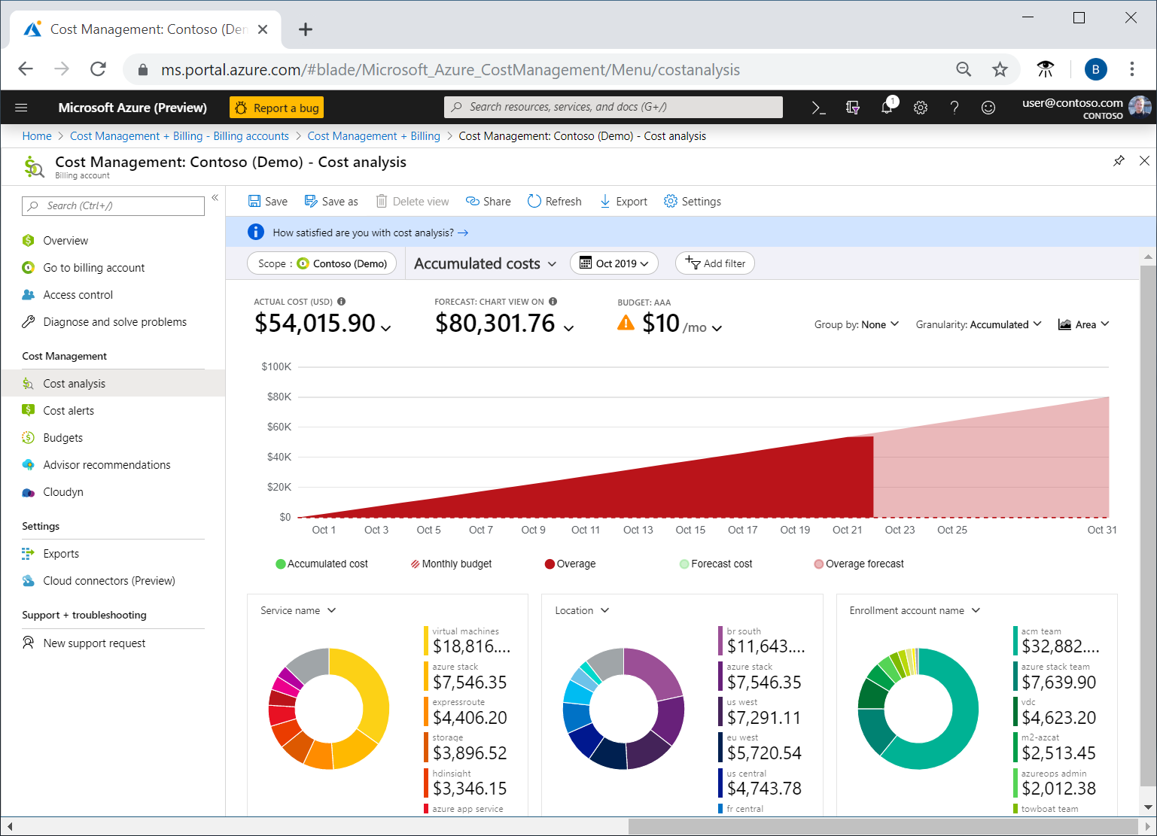
Azure Cost Analysis

Slide 14
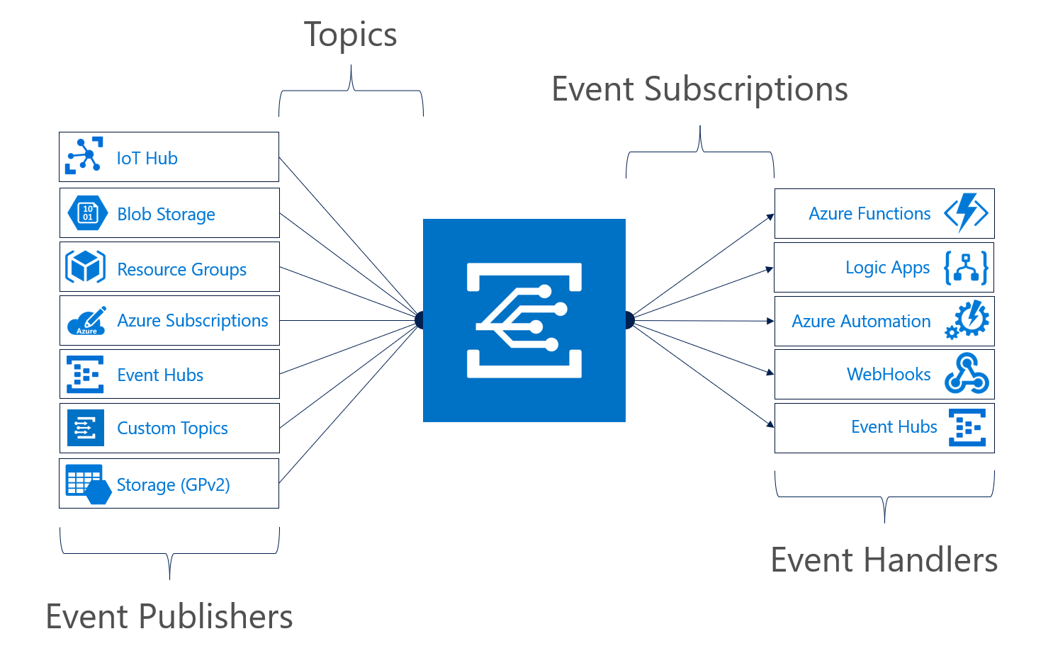
Azure Event Grid

Slide 15
Identity Design

Slide 16

Azure AD SSO
henry.a.miller@companycom.onmicrosoft.com
Cl0udpa$$111!
Henry-miller@company.com
myPa$$w0rd122!

Slide 17
Azure AD SSO
Henry-miller@company.com
myPa$$w0rd122!
Henry-miller@company.com
myPa$$w0rd122!

Slide 18

Passthrough Authentication

Slide 19

Seamless Single Sign-On

Slide 20

AD FS Federation

Slide 21


Azure AD B2C

Slide 22

Azure AD Domain Services

Slide 23
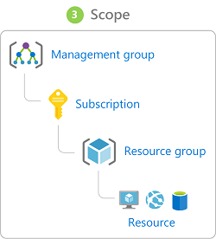
Azure Management Scopes
/ Tenant Root

Slide 24
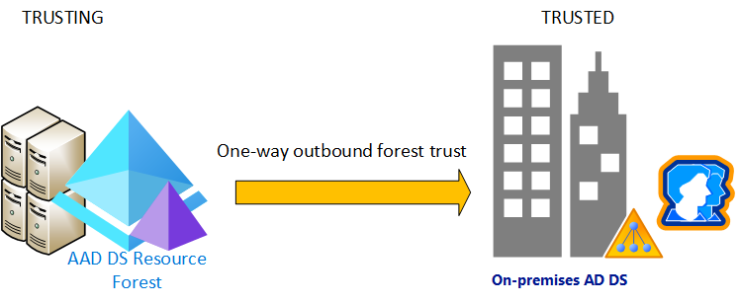
Azure AD Domain Services

Slide 25

Azure AD and Subscriptions

Slide 26
Data Platform Solution Design

Slide 27

Availability Set

Slide 28

Availability Zone

Slide 29
Storage Account Replication
1
3
3
2
LRS
ZRS

Slide 30
Storage Account Replication
1
3
1
3
2
2
GRS – RA/GRS

Slide 31
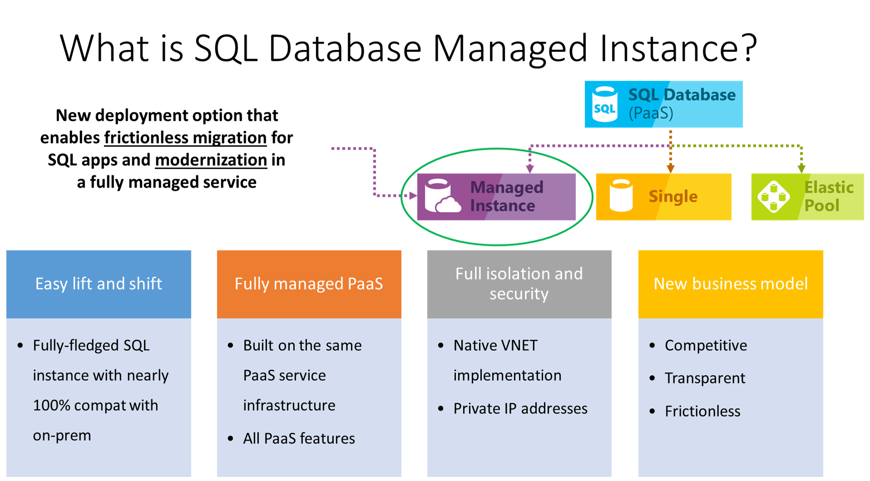

Slide 32
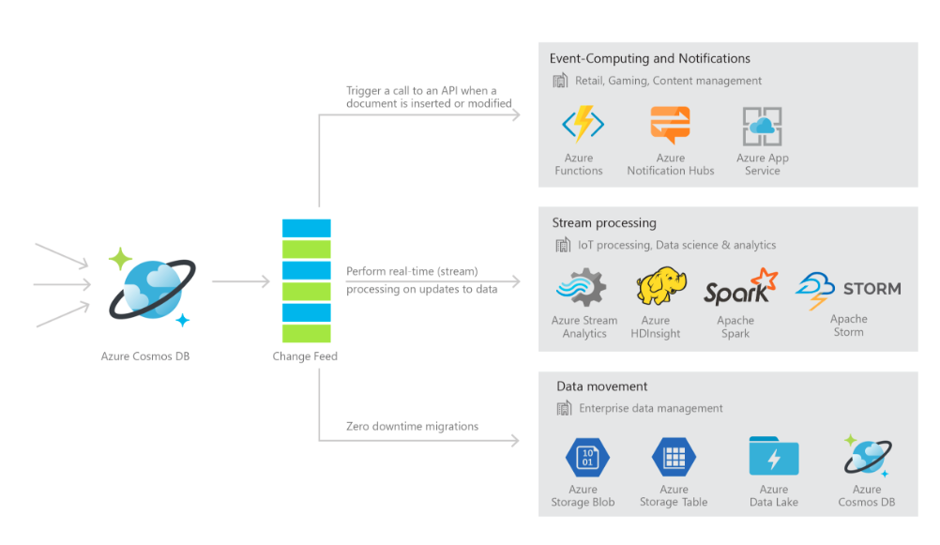
Cosmos DB

Slide 33

Always Encrypted

Slide 34
Infrastructure/Workload Design

Slide 35
Infrastructure/Workload Design

Slide 36

VM High Availability

Slide 37

Web App High Availability

Slide 38
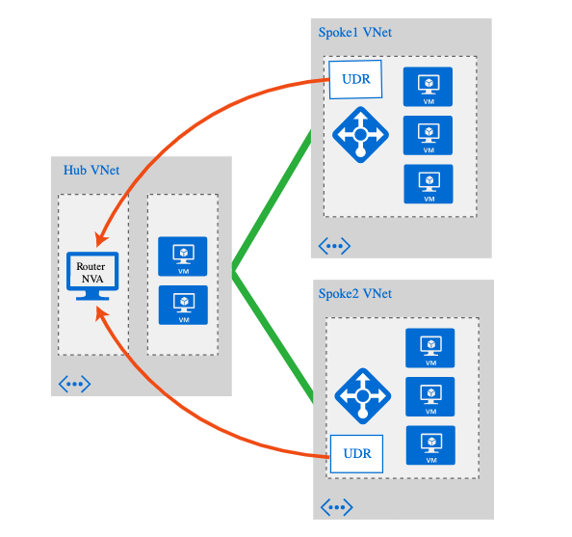
Hub and Spoke Networking

Slide 39
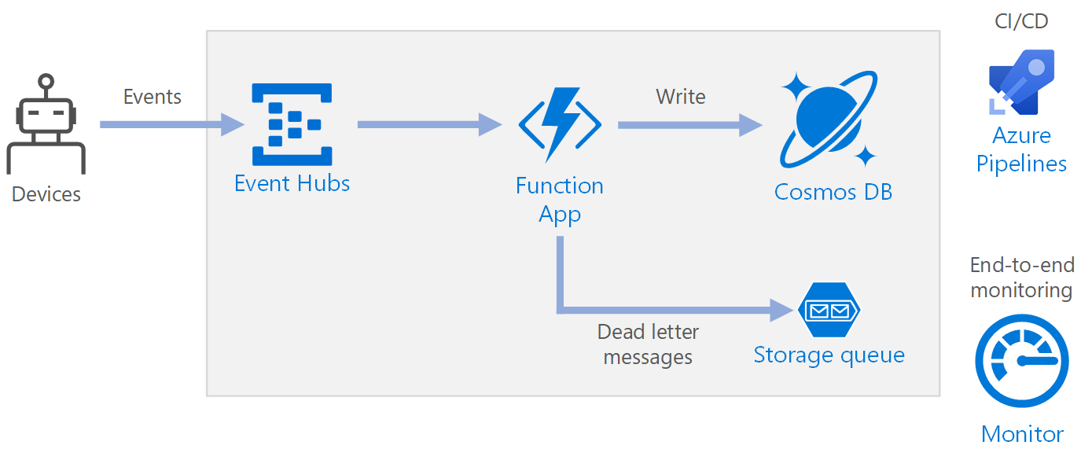
Azure Event Pipeline

Slide 40
Business Continuity/High Availability Design

Slide 41
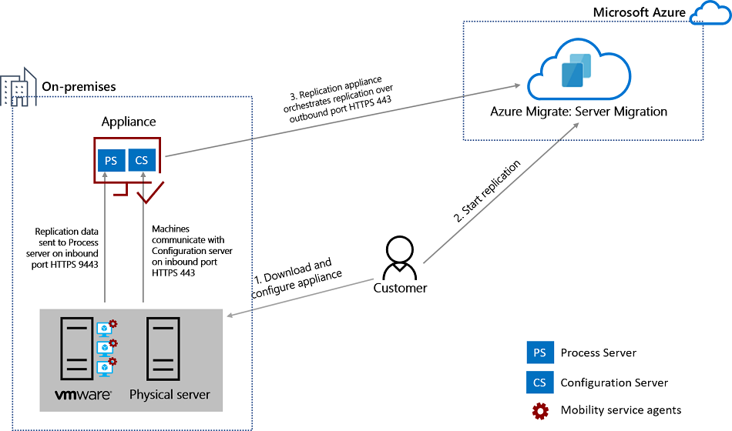
Azure Migrate

Slide 42
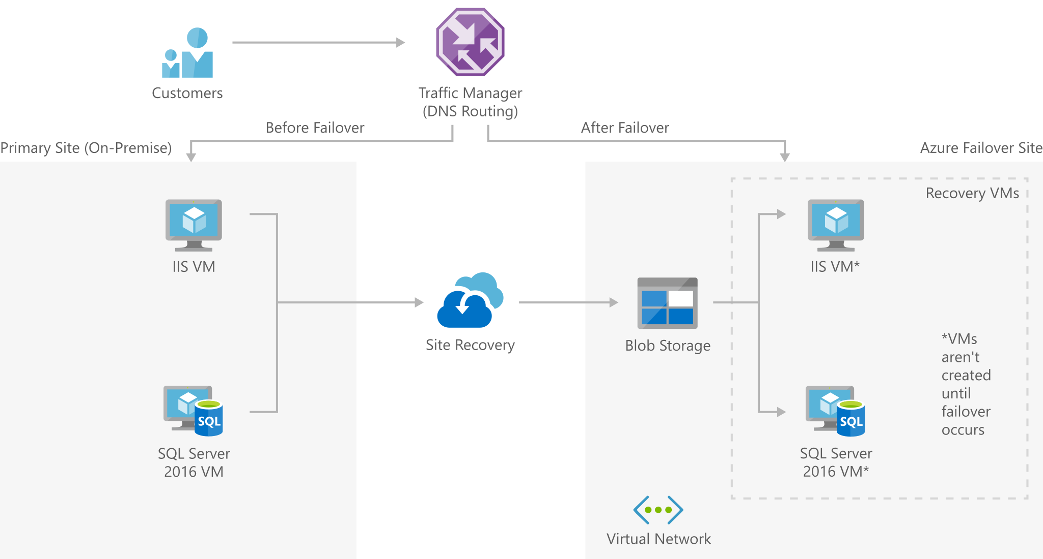
Azure Site Recovery (ASR)

Slide 43
Exam AZ-301-304 Item Types

Slide 44

Single-Answer Multiple Choice

Slide 45
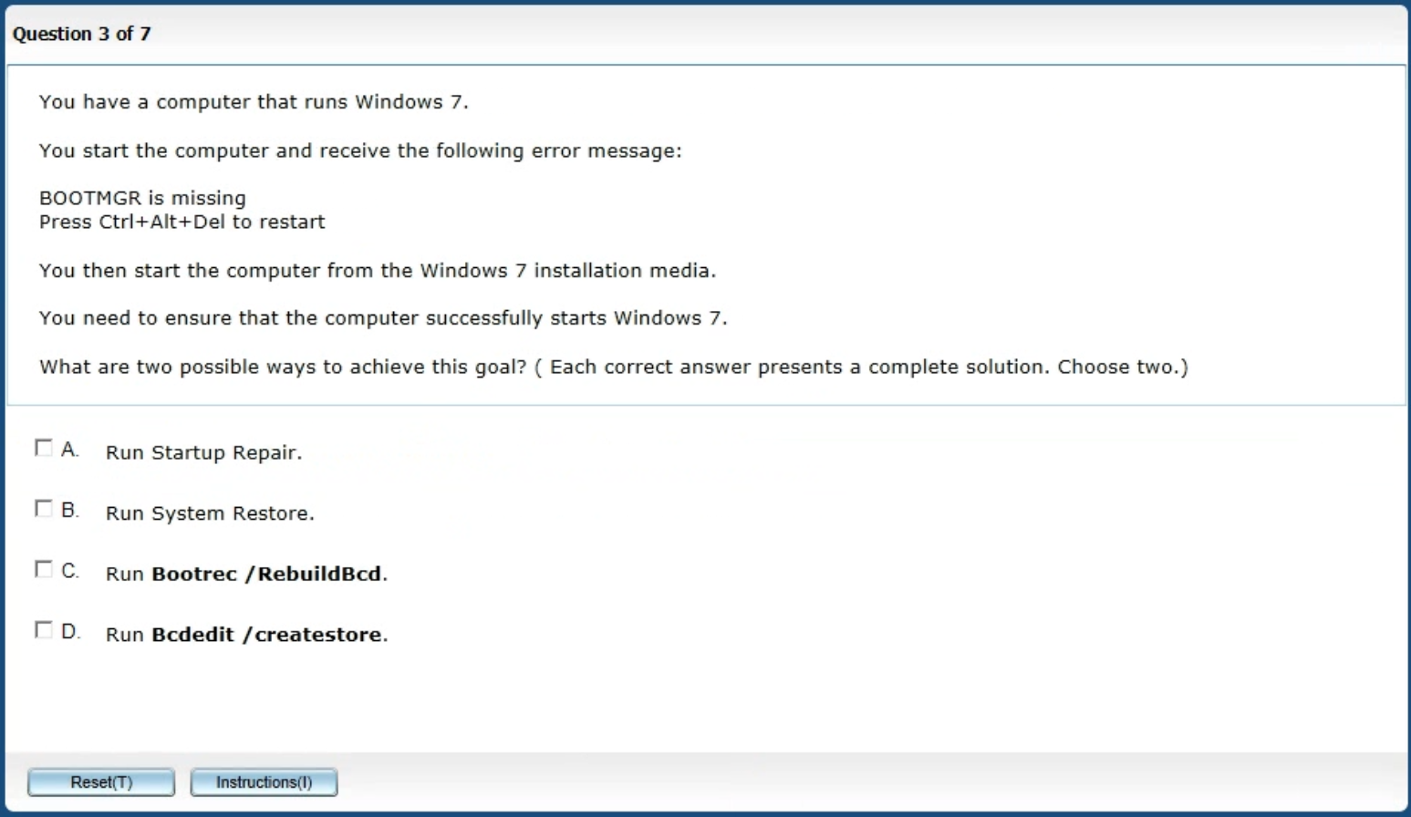
Multiple-Answer Multiple Choice

Slide 46
Repeated Scenario
You need to move an Azure VM to another hardware host.
Solution: You redeploy the VM.
Does this solution meet the goal?
Yes
No

Slide 47
Repeated Scenario
You need to move an Azure VM to another hardware host.
Solution: You restart the VM.
Does this solution meet the goal?
Yes
No

Slide 48

Select and Place

Slide 49

Build List and Reorder

Slide 50

Active Screen

Slide 51

Case Study

Slide 52
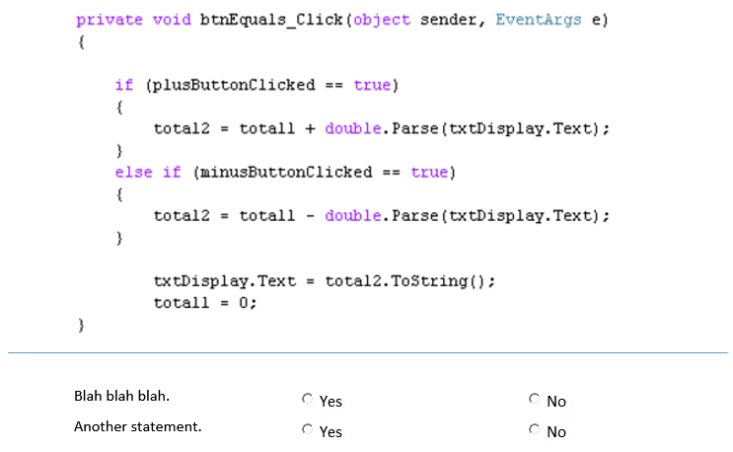
Statement / Code Analysis

Slide 53






Performance-Based Lab

Slide 54
Thank you!
Course materials: timw.info/az301
Twitter: @TechTrainerTim
Work: timw.info/ps
Web: TechTrainerTim.com

